Slide 1

Phishing Facts
Be Aware and Do Not Take the Bait!

Slide 2

Content
What is Phishing?
Types of Phishing Attacks
Results of Successful Phishing Attacks
Tips for Identifying a Phish
Best Practices

Slide 3
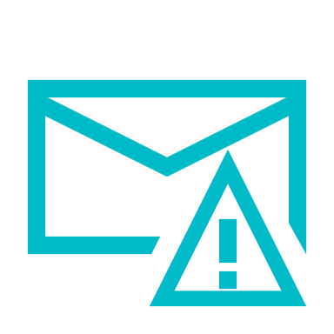
What is Phishing?
Phishing is an online scam where criminals send fraudulent email messages, appearing legitimate. The emails contain links or attachments that trick recipients into entering confidential information (e.g. account numbers, passwords) into fake websites, or they infect computers with malware.

Slide 4
Types of Phishing Attacks
Spear Phishing is a targeted attempt to steal sensitive information, typically focusing on a specific individual or organization. These types of attack use personalized facts in order to appear legitimate. Generally, cybercriminals turn to social media and company sites to research their victims.
Vishing is a phone scam, and has the most human interaction of all the phishing attacks. The fraudsters deceive victims by creating a sense of urgency to divulge sensitive information. Calls are often made through a spoofed ID, so it looks like a trustworthy source.
Whaling A Whaling attack is an attempt to steal sensitive information from senior-level management. Whaling emails contain highly personalized information about the target or organization, so they are more difficult to detect.
Smishing is a type of phishing that uses text (SMS) messages, as opposed to emails, to target victims. Fraudsters send a text message to an individual, usually calling for the individual to act.
Clone Phishing, a legitimate and previously delivered email message is used to create an identical email with malicious content. The cloned email will appear to come from the original sender and will contain malicious links or attachments.

Slide 5
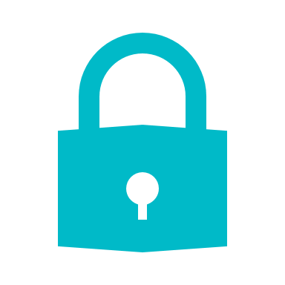
Successful Attacks Result in…
Identity Theft
Loss of Sensitive Information (personal or professional)
Loss of Intellectual Property
Data Sold to Criminals and Third Parties
Financial Losses
Unauthorized Transactions
Exposed Usernames and Passwords
Malware and Ransomware Installation
Backdoors (access to systems) to Launch Future Attacks
Reputational Damage

Slide 6

Tips for Identifying a Phish
Look for Messages with
Mismatched URLs
Poor Grammar or Spelling
Unexpected Correspondence/Unsolicited Requests
Urgent or Threatening Language

Slide 7
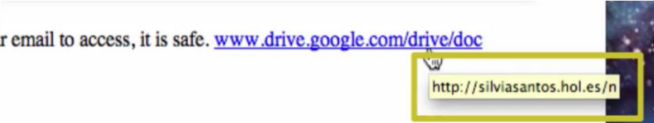
Mismatched URLs
Before clicking on any link, check the validity of the URL. • Hover your cursor over the URL link—without clicking on it. The full hyperlinked address appears. If the URL does not match the address displayed, the message is most likely fraudulent.
if you question the validity of the link, • Call a known phone number (not one from the email) and ask about the message. • Visit a trusted website (by manually typing the address in your browser).

Slide 8
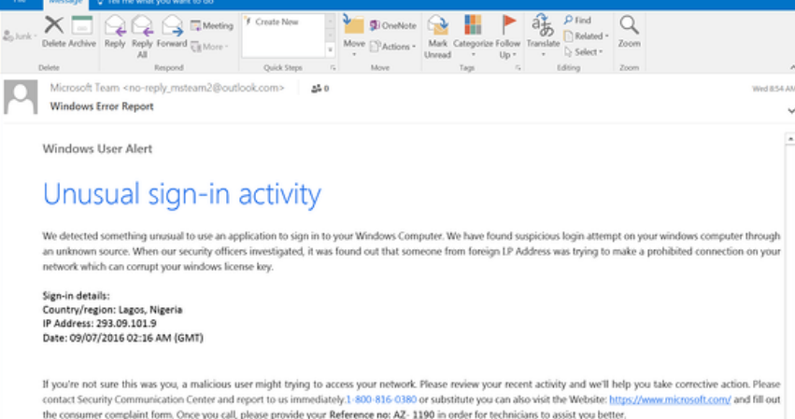
Poor Grammar and Spelling
Many phishing emails contain misspelled words and poor sentence structure. If you easily detected grammar-related errors in a message, it may be a phish. In the email example to the left
No individual word is mispelled, but the message is full of grammatical errors that a native speaker wouldn’t make, e.g., “We detected something unusual to use an application,” and a string of missed words, such as “a malicious user might trying to access.”
Look for obvious errors!
This is not to say an email with a mistake is a scam. Everyone makes typos from time to time.

Slide 9
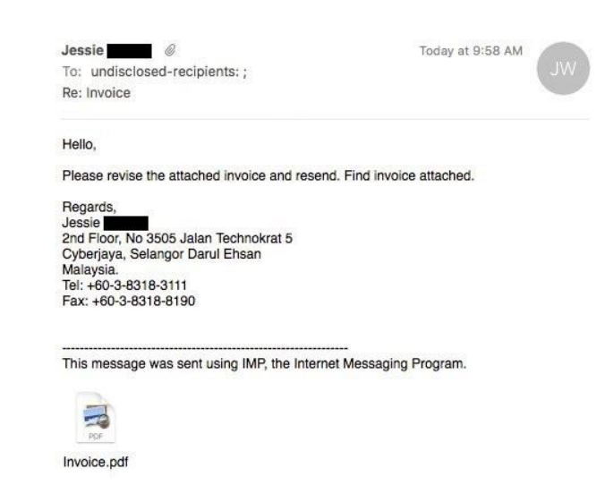
Unexpected Correspondence/ Unsolicited Requests
In the example, the phisher claims to be sending an attached invoice. The attachment in this message may look fine; however, it contains malware. When the recipients open the attachment, they will soon realize the invoice is not an invoice for them. Clicking the attachment releases malware, which could perform any number of nefarious activities on the victims’ computers. Never open an attachment unless you are confident that the message is from a legitimate party.

Slide 10
Urgent or Threatening Language
A common phishing tactic is to promote a sense of fear or urgency, pressuring the recipient to quickly click on a link.
Cybercriminals will often use threats that your security or privacy is compromised and that urgent action is required to remedy the situation.
Therefore, be cautious of subject lines that claim “Unauthorized login attempt” or “Your account has been suspended.”
If you are unsure if the request is legitimate, contact the company directly via its official website or official telephone number.
Scammers will use common services, such as PayPal and Netflix, in a phish because individuals do not like problems with accounts could cause immediate inconveniences.

Slide 11
Best Practice
Top Tip: Look at the email address, not just the sender
Ensure the message is not sent from a public email domain; no legitimate organization will contact you from an address that ends ‘@gmail.com’, not even Google. Legitimate emails from Google will read ‘@google.com’.
If the domain name (after the @ symbol) matches the apparent sender of the email, the message is more likely to be legitimate.
Never click on suspicious links or attachments, especially from unsolicited messages
Go to the source if you have questions about the validity of the URL or message
Check the website security
Ensure there is a padlock symbol in the URL address bar OR
Ensure the URL begins with https:// or shttp://. The added “s” indicates that the data will encrypted in transit.
Create strong passwords on all accounts

Slide 12

Awareness is Key
Thank you for reviewing the content of this training. Your ability to identify a phishing attack is important.
USU Central IT has advanced technologies that filter thousands of spam and phishing messages each day. However, filters will never be 100% effective.
SCCE Community members must consistently analyze the context of their email and text messages, looking for anything suspicious before replying, clicking links, or opening attachments.

Slide 13
Resources
IT Governance, IT Governance Blog, 6 Jun 2019, https://www.itgovernance.co.uk/blog/5-ways-to-detect-a-phishingemail [extracted 28 Feb 2020]
MediaPro, 3 PII Phishing Tactics, 14 Nov 2017, https://www.mediapro.com/blog/infographic-3-pii-phishing-tacticslook-out-for/ [extracted 17 Jan 2019]
PhishLabs, Phishing: Number One Cause of Data Breaches: Lessons from Verizon DBIR, 27 Jun 2019, https://info.phishlabs.com/blog/phishing-number-1-data-breaches-lessons-verizon [extracted 28 Feb 2020]
USU Information Security Training, ils.usu.edu • Verizon, Verizon Data Breach Report, https://enterprise.verizon.com/resources/reports/dbir/ [extracted 15 Oct 2019]

Slide 14
Thanks
Created by Mostafa Ahmed El-Ashmawy

